Slide 1
Floating Solar Analysis
Date: [06-05-2026]
By: Clayton Hanna, Trevor Schonbrun, Mathias Fay

Slide 2
Task 1: Data to be used
Data Link: https://catalog.data.gov/dataset/high-resolution-floating-solar-pv-data
Data Source: Department of Energy - High-Resolution Floating Solar PV Data
Available Data sets: 16
Dataset filetype: .csv
File size: ~10-80 Mb
Resolution: data point every 5 minutes (24/7)
Specific datasets of choice: FPV_Oakville_CA_Inverter1.csv
FPV_Altamonte_FL_data.csv
Dataset description:
Data is time, voltage and resistance (as well as some temperature and other water-related) data acquired on a set of floating solar panels positioned in locations such as Oakville, California, as part of a survey of the meteorological conditions of the area. The voltage and time data can be used to identify details about the location such as the length of daylight for each day, the intensity of it, the frequency of solar impacting weather (such as clouds or storm), and solar incidence based on long term conditions (seaons).

Slide 3
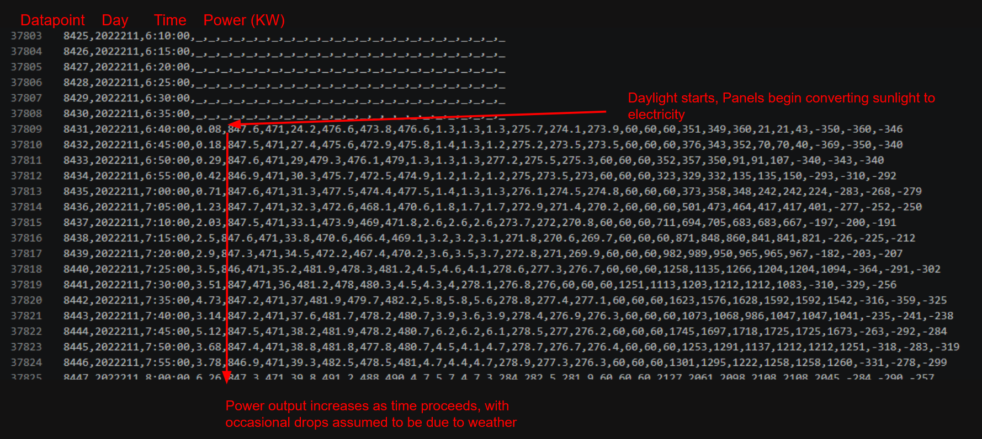
Task 1: Understanding the data

Slide 4
Task 2: Developing questions
(1) What is the length of a daylight period in Oakville?
Establishing a baseline length of time for which the daylight of a day occurs is a good way to find out what would be reasonable “work” hours at the location. We can also use this information with other considerations (e.g average solar incidence curves) to figure out if there are unusual drops in solar radiation, thus suggesting interference due to weather. This question would be answered by finding when the solar rig begins to see a voltage gain to when it has a voltage drop, and marking the start time, length and end time of this period in a variable set. This value would be a length of time measured in hours and minutes.

Slide 5
Task 2: Developing questions
(2) What is the peak/average solar output of the panel (for a 24hr period)?
Determining optimal solar field locations is typically contingent one a few major things; cost of installation, environmental impact, and power output per cost. Since we have data on time and AC output, we can compare the max value and average values of the AC output power of the panel to obtain the actual “production” of power per space. This value would be a wattage.

Slide 6
Task 2: Developing questions
(3) How does solar panel temperature affect power output in PV systems?
The efficiency of a solar panel refers to how much sunlight it can convert into usable energy. Due to the physics of solar cells, solar panels become less efficient as their temperature increases. Typically, solar panels lose 0.3% to 0.5% efficiency for every 1°C increase in temperature above 25°C, but it would be important to find the true value for this dataset. The variables of interest for this question are the various panel temperatures and the inverter AC power output. By graphing the power output at various panel temperatures, the effect of temperature can be determined. This value would be a expression of how wattage is related to the temperature.

Slide 7
Task 2: Developing questions
(4) What is the frequency of clouds?
Based on variance in the output of the solar panels, what percentage of time, and how many of these differences in output, occur per day? This could be inferred by modelling the expected output based on the top three or five values out of a range of data points, and seeing if the actual data gathered follows that curve closely or not; if not, then the periods where it is lower than expected are likely to have experienced clouds. Some issues may occur if the area experiences clouds the entire daylight period (which may require comparison/extrapolation by other days to resolve). This value would be a number of instances, and a % value or time value for period of cloudiness.

Slide 8
Task 2: Developing questions
(5) Which environmental factors have the biggest impact on power output?
Many environmental variables are measured in this dataset, such as relative humidity, irradiance, ambient temperature, water temperature, and wind speed and direction. Some of these may greatly affect the power output of the floating PV system, while others may not. Determining which variables affect the performance of the system could lead to future improvements in overall system design. This would be calculated by comparing variance of specific variables to the variance of output DC power. The values for this would be a relation comparing the dependant variable (output power) to input variables (all other variables).

Slide 9
Task 2: Developing questions
(6) How does power output vary over time?
The datasets provided do not have a clear definite start date. They provide a seven digit number that increases by one every day. If we make some inferences based on changes in solar incident radiation on earth based on position, what is the day which a specific section of data is attached to? This would be identified by comparing the expected relative curves of the regions normal power output per meter to our datasets, and seeing how the variance over long-term time (months) compares to other cleaned and identified datasets. This would be measured in a relation based on watts per time.

Slide 10
Task 3: Potential Questions
Question | What aspect/feature will be used? | Can we answer this question? | Do we answer this question? | Justification:
1. What is the length of a daylight period in Oakville? | Time & DC Voltage readings | Yes | No | This is a region specific detail that is easily kept track of by other organizations.
2. What is the peak/average solar output of the panel (for a 24hr period)? | Time & AC power output | Yes | Yes | This data could be used by solar investment organizations.
3. How does solar panel temperature affect power output in PV systems? | Panel temp, AC power output | Yes | Yes | This becomes important as the global environment sees more aggressive temperature changes.
4. What is the frequency of clouds? | Time & AC power output | Yes | No | Making inferences on clouds would require more data in order to make proper extrapolations.
5. Which environmental factors have the biggest impact on power output? | Relative humidity, irradiance, ambient temperature, water temperature, wind speed and direction, AC power output | Yes | No | Comparing all the variables here would require extensive studying of many data combinations, and may exceed our capabilities.
6. How does power output vary over time? | Time & AC power output | Yes | Yes | This builds on the data from option 2 and is likewise useful for long term considerations.

Slide 11
Task 4: Q1: What is the peak/average solar output of the panel (for a 24hr period)?
Metrics to be Calculated | Tools & Python Packages | Effective Plots & Visualizations
Daily Peak Power (kW) Daily Average Output (kW) | Pandas Numpy Matplotlib | Histogram Box plot 24 hour Line Plot

Slide 12
Task 4: Q2: How does power output vary over time?
Metrics to be Calculated | Tools & Python Packages | Effective Plots & Visualizations
Daily total energy gathered (kJ) Days that actually have data (kJ) | Numpy Matplotlib | Box plot Scatter plot Bar graph

Slide 13
Task 4: Q3: How does solar panel temperature affect power output in PV systems?
Metrics to be Calculated | Tools & Python Packages | Effective Plots & Visualizations
Average irradiance Peak panel temperature Peak AC power | NumPy Pandas Matplotlib SciPy | Line plot

Slide 14
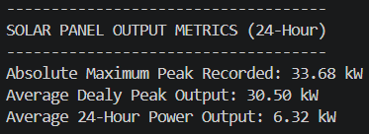
Task 5: Q1: What is the peak/average solar output of the panel (for a 24hr period)?

Slide 15
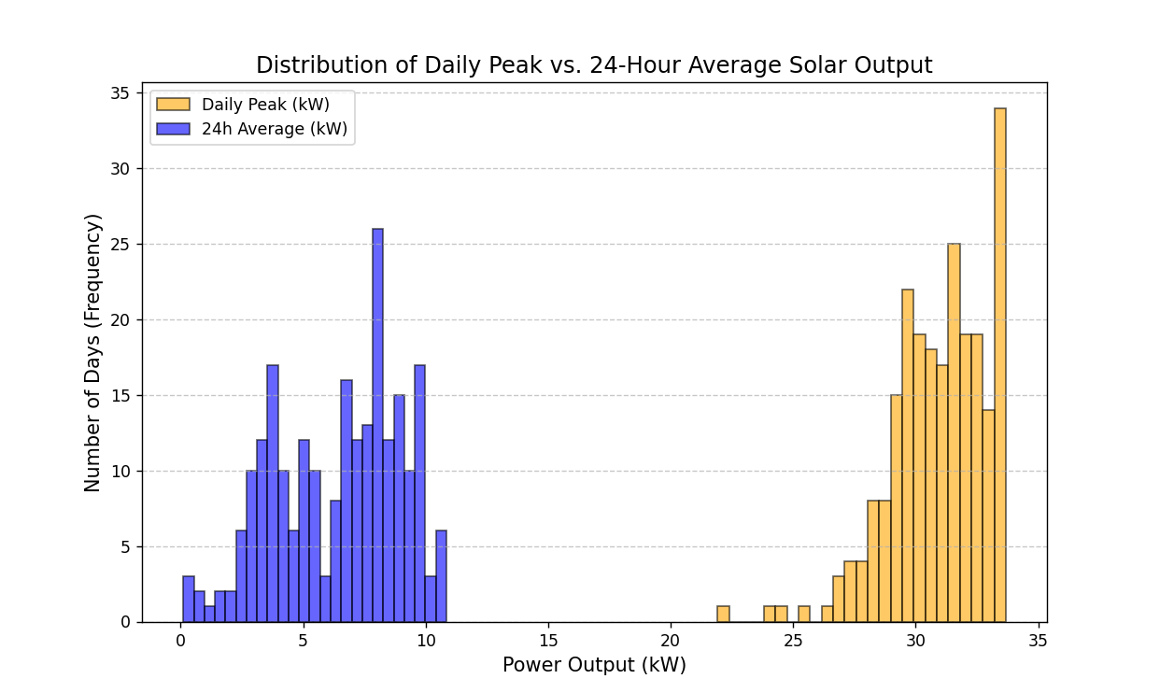
Task 5: Q1: What is the peak/average solar output of the panel (for a 24hr period)?

Slide 16
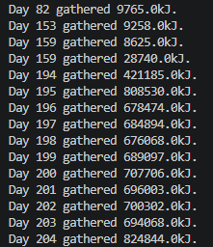

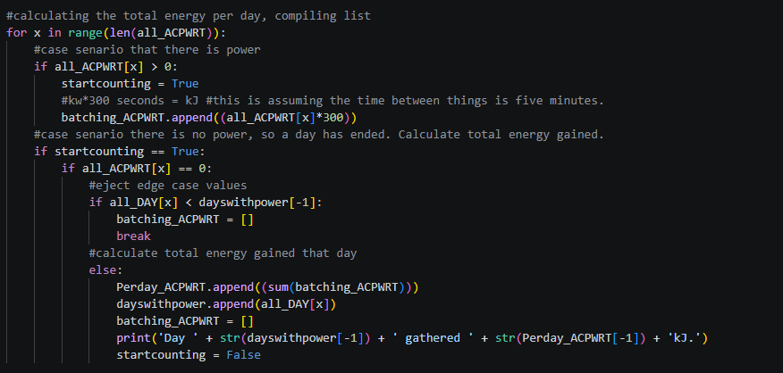
Task 5: Q2: How does power output vary over time?

Slide 17
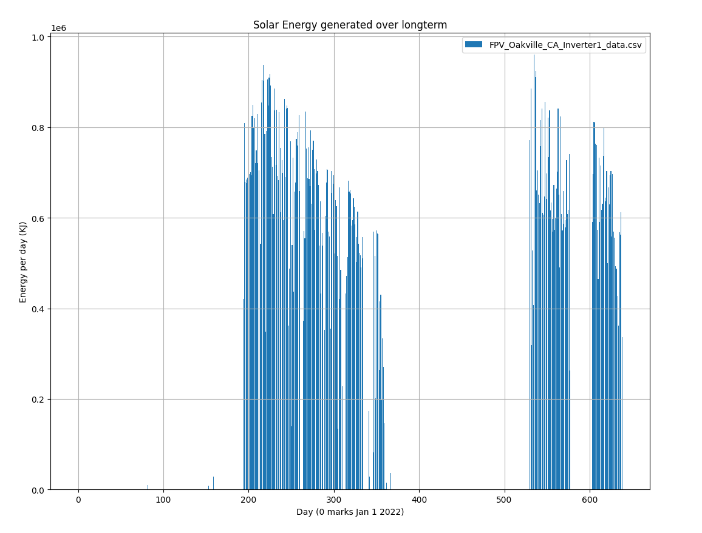
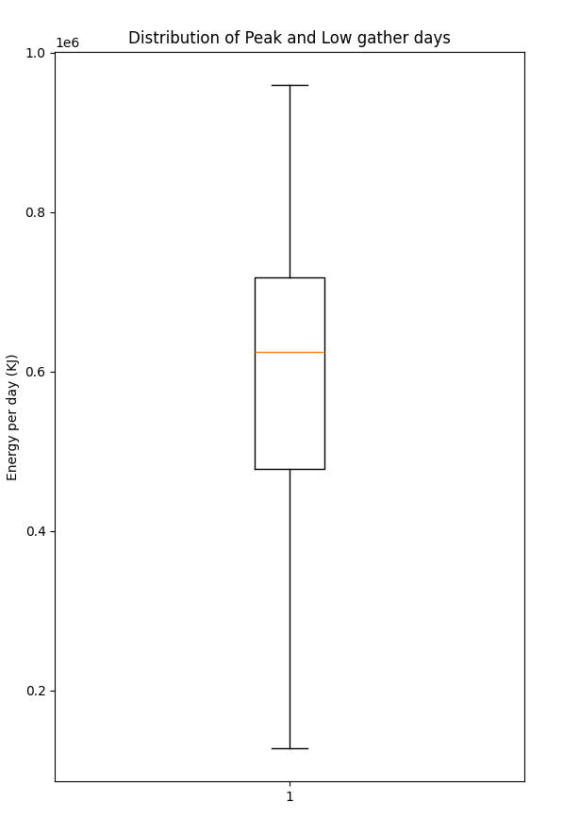
Task 5: Q2: How does power output vary over time?

Slide 18
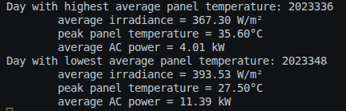
Task 5: Q3: How does solar panel temperature affect power output in PV systems?

Slide 19
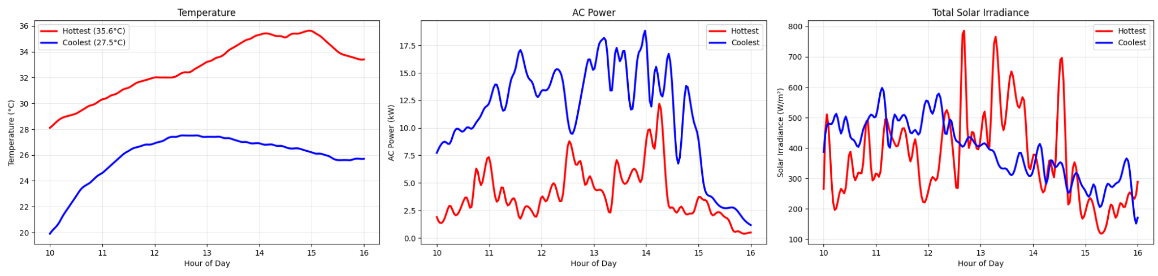
Task 5: Q3: How does solar panel temperature affect power output in PV systems?

Slide 20
Task 6: Q1: What is the peak/average solar output of the panel (for a 24hr period)?
The absolute peak solar output of the panel over a 24 hr period was 33.68 kW
The average 24-hour power output measured was 6.32 kW
Expected Relationship:
It was expected that higher daily peaks would correspond to higher daily averages
Observed Relationships
The data shows a positive relationship
The days with higher peak output generally had a higher average output
There is a clear trend. Solar output follows expected patterns where peak production aligns with overall daily performance.
This could influence solar panel installation choices.

Slide 21
Task 6: Q2: How does power output vary over time?
Solar energy gathered during summer months seems to be greater than winter months
Limited data makes it difficult to properly map out full range of season to energy generation
Energy generation stays within certain bounds (see middle 50% boxchart) some days experience very high or low energy generation.
Even worst case scenario typically generates about ~10% generation potential
Electricity grid operators would need to factor in the risk and implement reserve power sources, especially during the colder months.

Slide 22
Task 6: Q3: How does solar panel temperature affect power output in PV systems?
Expected average power to be lower at higher temperatures
Results were inconclusive:
In some cases, average power output decreased with higher temperature
In others, it was the opposite or there was no trend
Limiting factors:
Quality of data (missing values)
Number of factors affecting power output
Further analysis could be done to find days with multiple similar conditions (irradiance, wind speed, humidity, etc.)

Slide 23
Task 7: Q1: What is the peak/average solar output of the panel (for a 24hr period)?
Reflection:
This project showed me that working with real data is a lot messier than expected. Cleaning the data set took more effort than the actual calculations
One thing that surprised me was how small issues in the data could completely change the results
If I did this again, I would spend more time exploring and validating the dataset before starting analysis.
I feel more confident working with Python, especially using libraries like pandas and matplotlib to analyze real datasets
My problem-solving skills have improved, especially when debugging errors

Slide 24
Task 7: Q2: How does power output vary over time?
Reflection:
Our original question wasn’t particularly specific, so we had to establish what we meant by “over time” to mean in relation to seasons.
There are many ways to process the data (e.g. aggregate based on approximate month basis)
Since our dataset is missing a full collection of data, figuring out how to extrapolate what would be the expected variance and sinusoidal relation between the peak and low periods of a year could be able to make up for this limitation.
Ensuring data variety compatibility is difficult when the data style changes from dataset to dataset (some datasets contain more variables, don’t fill some variables as much, ect).

Slide 25
Task 7: Q3: How does solar panel temperature affect power output in PV systems?
Reflection:
The quality of the data matters. Our dataset was huge, but had many invalid or missing data points.
Experimental conditions can greatly impact data. The data had many factors that could cause a change in power output.
These factors make this question extremely difficult to explore further. The number of days with similar conditions is already limited (<50 days out of 2+ years) when only comparing irradiance

